Slide 1


MODULE 02 I PERSONNEL
The manufacture of Pharmaceuticals products depends on people. Good Manufacturing Practice (GMP) requires that personnel are qualified, trained, and organized to ensure product quality and patient safety. This module explains the roles, responsibilities, training, and hygiene requirements for pharmaceutical industry personnel.
1

Slide 2

MODULE 02 I PERSONNEL
"The correct manufacture of medicinal products relies upon people."
2

Slide 3

MODULE 02 I PERSONNEL
Principle:
  Sufficient qualified personnel must be available.
  Responsibilities must be clearly defined and documented.
  All staff should understand GMP principles and receive initial and ongoing training, including hygiene instructions.
3

Slide 4

MODULE 02 I PERSONNEL
General Requirements:
  Adequate number of qualified staff with practical experience.
  Senior management must provide resources (human, financial, materials, facilities, equipment).
  Responsibilities should not be excessive to avoid risks to quality.
  Organization chart must show relationships between Production, Quality Control, Quality Assurance, or Qualified Person(s).
  Written job descriptions are mandatory.
  Senior management holds ultimate responsibility for the quality management system.
4

Slide 5

MODULE 02 I PERSONNEL
Qualified Person (QP)/Quality Assurance
  Ensures each batch complies with laws and marketing authorization.
  Certifies batches before release.
  Duties may only be delegated to another QP/QA.
  Must be continuously available to the manufacturer.
5

Slide 6
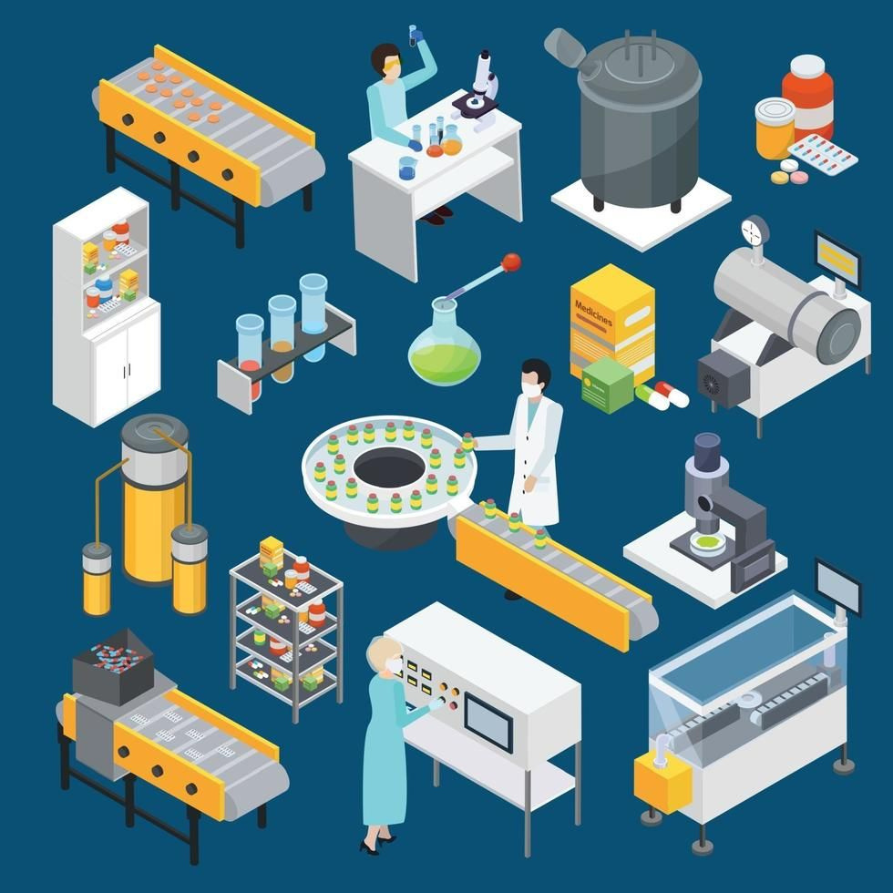
MODULE 02 I PERSONNEL
Head of Production
  Ensures products are produced and stored according to documentation.
  Approves production instructions and ensures strict implementation.
  Evaluates and signs production records.
  Maintains premises, equipment, and validations.
  Oversees training of production staff.
6

Slide 7

MODULE 02 I PERSONNEL
Head of Quality Control
  Approves or rejects materials and products.
  Ensures all necessary testing is carried out.
  Approves specifications, sampling instructions, and test methods.
  Monitors contract analysts.
  Maintains QC facilities and equipment.
  Oversees training of QC staff.
7

Slide 8

MODULE 02 I PERSONNEL
Shared Responsibilities
Production, QC, and QA heads share duties such as:
  Authorizing procedures and documents.
  Monitoring manufacturing environment and plant hygiene.
  Process validation.
  Supplier and contractor approval.
  Storage condition monitoring.
  Record retention.
  GMP compliance monitoring.
  Management reviews and continual improvement.
8

Slide 9

MODULE 02 I PERSONNEL
Training
  All personnel must receive training relevant to their duties.
  Basic GMP and quality system training for new recruits.
  Continuing training with periodic effectiveness checks.
  Training programs approved by Production or QC heads.
  Special training for personnel in cleanrooms or handling hazardous materials.
  Visitors should be avoided in production/QC areas; if unavoidable, they must receive hygiene instructions and supervision.
9

Slide 10
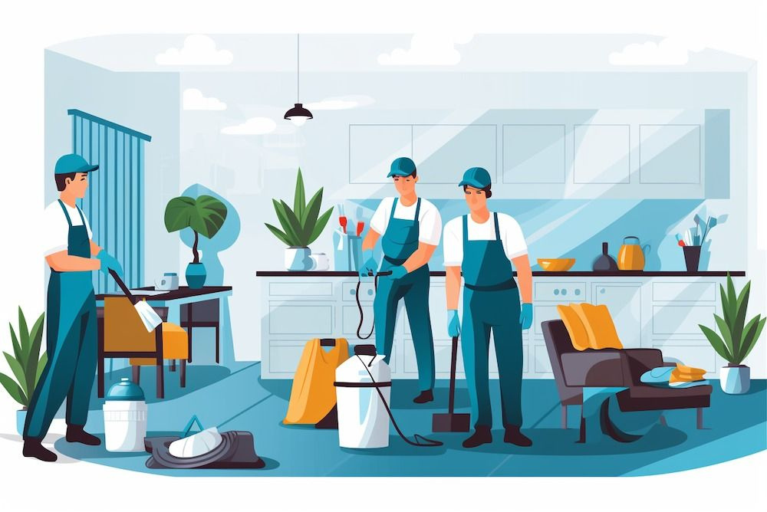
MODULE 02 I PERSONNEL
Personnel Hygiene
  Hygiene programs must cover health, practices, and clothing.
  Medical examination required at recruitment; follow-up exams as needed.
  Personnel with infectious diseases or open lesions must not work in manufacturing.
  Protective garments required in manufacturing areas.
  Eating, drinking, smoking, or storing food/medication in production areas is prohibited.
  Direct hand contact with products/equipment must be avoided.
  Hand-washing facilities must be used.
10

Slide 11
MODULE 02 I PERSONNEL
Consultants
  Must have adequate education, training, and experience.
  Records must be kept of their qualifications and services provided.
11

Slide 12
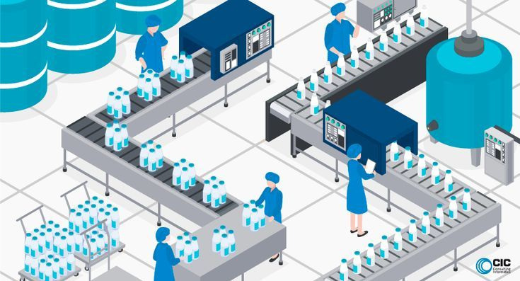
MODULE 02 I PERSONNEL
Key Takeaways
  GMP compliance depends on people as much as processes.
  Clear responsibilities, adequate training, and strict hygiene are non-negotiable.
  Senior management must lead by example, ensuring resources and oversight.
  The QP/ QA plays a central role in product release and compliance.
12

