Slide 1
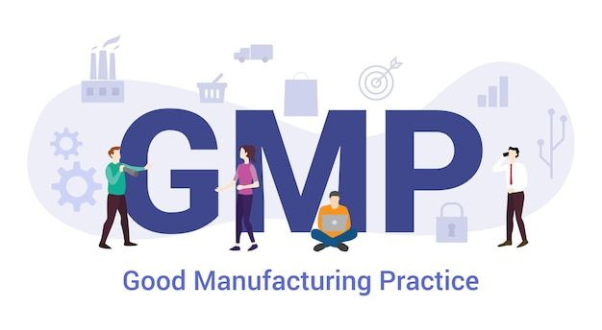

MODULE 03 I PHARMACEUTICAL QUALITY SYSTEM
Pharmaceuticals products must be manufactured to the highest standards to ensure they are safe, effective, and consistently reliable for patients. Good Manufacturing Practice (GMP) guidelines provide the framework for achieving this, and at the heart of GMP lies the Pharmaceutical Quality System (PQS).
The PQS is not just a set of procedures—it is a company-wide commitment to quality. It requires leadership from senior management, active participation from staff at all levels, and cooperation with suppliers and distributors. By integrating Quality Management, GMP, and Quality Risk Management, the PQS ensures that every stage of a product’s lifecycle—from development to discontinuation—is controlled and monitored.
1

Slide 2
MODULE 03 I PHARMACEUTICAL QUALITY SYSTEM
This system emphasizes:
  Clear responsibilities and accountability.
  Proper design and validation of processes.
  Continuous monitoring and improvement.
  Risk-based decision-making to protect patients.
Ultimately, the PQS is about building trust: trust that every medicine reaching a patient has been produced with care, precision, and responsibility.
2

Slide 3

MODULE 03 I PHARMACEUTICAL QUALITY SYSTEM
"The correct manufacture of medicinal products relies upon people."

Slide 4

MODULE 03 I PHARMACEUTICAL QUALITY SYSTEM
Purpose:
  Ensure medicines are safe, effective, and of consistent quality.
  Protect patients by preventing risks from poor manufacturing practices.
  Provide a framework for companies to manage quality across all stages of a product’s life.
3

Slide 5
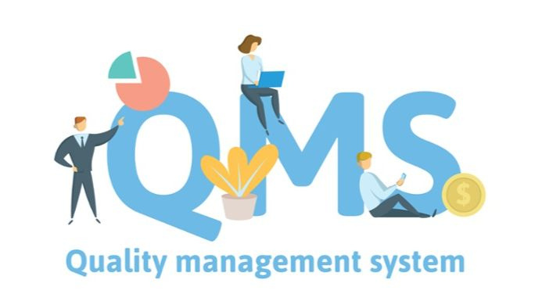
MODULE 03 I PHARMACEUTICAL QUALITY SYSTEM
Core Principles:
  Responsibility: Senior management is ultimately accountable for product quality.
  Commitment: All staff, suppliers, and distributors must contribute to quality.
  System: A documented Pharmaceutical Quality System (PQS) must be in place, monitored, and resourced.
4

Slide 6

MODULE 03 I PHARMACEUTICAL QUALITY SYSTEM
Key Components of PQS
  Clear roles and responsibilities.
  Reliable supply chain and approved materials.
  Control of outsourced activities.
  Monitoring of processes and product quality.
  Investigation of problems with corrective and preventive actions (CAPA).
  Certification of batches by a Qualified Person (QP)/Quality Assurance(QA).
  Proper storage, distribution, and handling.
  Regular self-inspections and audits.
5

Slide 7
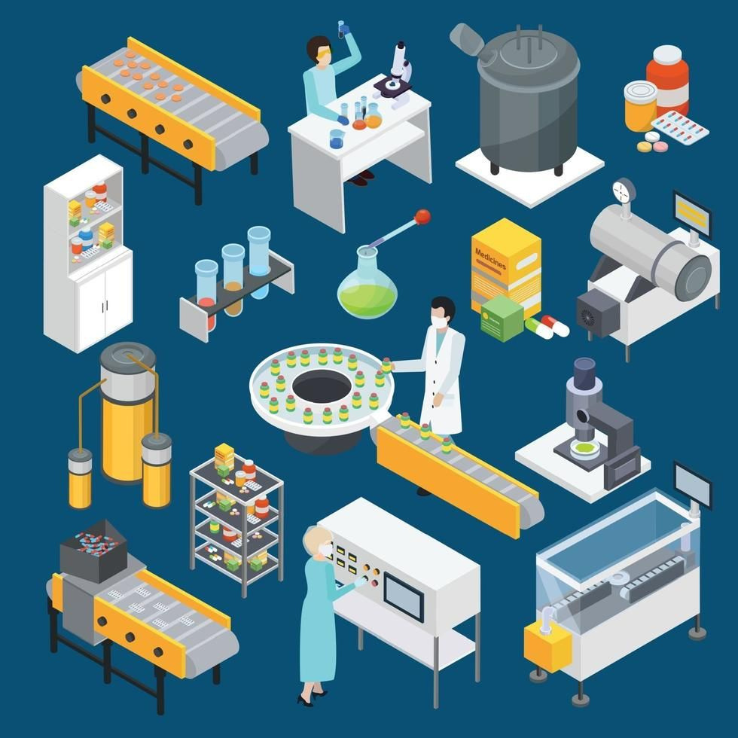
MODULE 03 I PHARMACEUTICAL QUALITY SYSTEM
Good Manufacturing Practice (GMP):
  Ensures medicines are consistently produced to required standards.
  Requires validated processes, trained staff, suitable facilities, and clear procedures.
  Records must show that all steps were followed.
  Deviations must be investigated and corrected.
  Systems must exist for recalls and complaint handling.
6

Slide 8
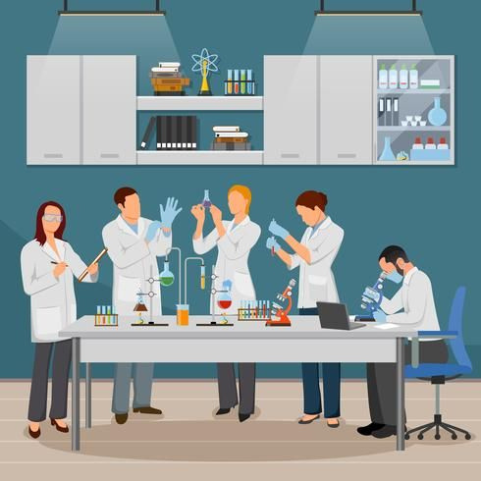
MODULE 03 I PHARMACEUTICAL QUALITY SYSTEM
Quality Control (QC)
  Focuses on testing and release of materials and products.
  Ensures products meet specifications before they are sold.
  Requires validated test methods and proper documentation.
  No batch is released without QP/QA certification.
  Reference samples are kept for future checks.
7

Slide 9

MODULE 03 I PHARMACEUTICAL QUALITY SYSTEM
Product Quality Review (PQR):
  Conducted annually to check consistency and identify improvements.
  Reviews materials, processes, deviations, complaints, recalls, and stability data.
  Helps companies spot trends and strengthen quality systems.
8

Slide 10

MODULE 03 I PHARMACEUTICAL QUALITY SYSTEM
Quality Risk Management (QRM):
  Systematic approach to assess, control, and review risks.
  Based on science, experience, and patient protection.
  Effort and documentation should match the level of risk.
  Can be used proactively (before problems occur) or retrospectively (after issues arise)
9

Slide 11

MODULE 03 I PHARMACEUTICAL QUALITY SYSTEM
Role of Senior Management
  Provide leadership and resources.
  Define responsibilities clearly.
  Conduct regular reviews of the PQS.
  Ensure a Quality Manual is in place.
10

Slide 12
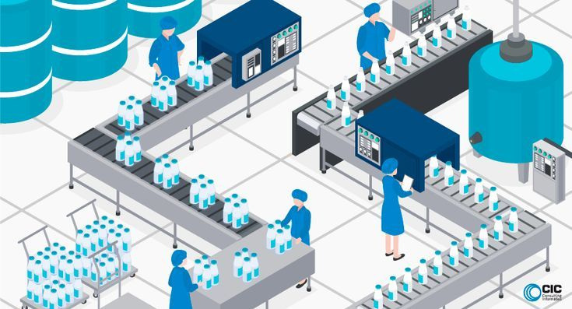
MODULE 03 I PHARMACEUTICAL QUALITY SYSTEM
Key Takeaways
  Pharmaceutical Quality System (PQS) is the backbone of GMP, ensuring medicines are consistently safe, effective, and of the right quality.
  Senior management holds ultimate responsibility for establishing, resourcing, and reviewing the PQS. Leadership commitment is essential.
  Good Manufacturing Practice (GMP) ensures processes are defined, validated, and controlled, with trained staff, suitable facilities, and clear documentation.
  Quality Control (QC) guarantees that products meet specifications before release, with proper testing, validated methods, and Qualified Person (QP) certification.
  Product Quality Review (PQR) provides an annual check on consistency, trends, and opportunities for improvement across materials, processes, and complaints.
11

Slide 13
MODULE 03 I PHARMACEUTICAL QUALITY SYSTEM
Key Takeaways
  Quality Risk Management (QRM) applies science and experience to assess and control risks, ensuring patient protection.
  Continual improvement is a central theme: processes, systems, and products must evolve based on monitoring, audits, and risk analysis.
  Documentation and traceability are critical — every step must be recorded to demonstrate compliance and enable investigation if issues arise.
  Collaboration across departments, suppliers, and distributors is necessary to maintain quality throughout the product lifecycle.
12

