Slide 1
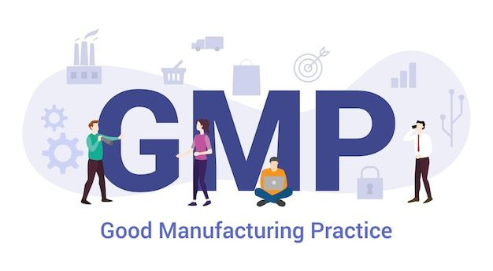

MODULE 01 I What is GMP?
What is GMP? GMP, or Good Manufacturing Practices, are rules and procedures that pharmaceutical and biotech firms must follow to ensure their products are produced and consistently meet specific requirements for identity, strength, quality, and purity. The fundamental standard for ensuring the quality of human pharmaceuticals is the cGMP regulation, according to FDA guidelines. cGMP stands for current Good Manufacturing Practices.
It consists of several practices that focus on different phases of manufacturing, as well as quality. It is worth noting that the cGMP regulation represents the minimum requirements that companies have already implemented in their quality and risk management systems.
1

Slide 2

MODULE 01 I What is GMP?
Patient safety is the most important part of GMP. The second most important pillar is drug effectiveness.
2

Slide 3

MODULE 01 I What is GMP?
In 1978, the U.S. Food and Drug Administration (FDA) finalized the Current Good Manufacturing Practice (cGMP) regulations for pharmaceutical products under 21 CFR Parts 210 and 211. These regulations became a major milestone in establishing consistent quality standards for the manufacture of drugs and remain a cornerstone of pharmaceutical compliance today.
For anyone beginning their GMP journey, understanding these regulations is essential because they define how medicines must be manufactured, processed, packaged, and stored to ensure they are safe, effective, and meet the quality standards claimed by the manufacturer.
3

Slide 4
MODULE 01 I What is GMP?
What is 21 CFR Part 210?
Part 210 provides the general cGMP requirements for manufacturing, processing, packaging, and holding of drug products. It outlines the systems, facilities, controls, and methods companies must implement to ensure product safety, identity, strength, quality, and purity.
In simple terms, Part 210 establishes the overall GMP framework that pharmaceutical companies must follow.
4

Slide 5
MODULE 01 I What is GMP?
What is 21 CFR Part 211?
Part 211 contains the specific minimum requirements for the preparation of finished drug products (excluding certain PET drugs). It covers critical areas such as:
  Personnel responsibilities
  Building and facility controls
  Equipment qualification and maintenance
  Production and process controls
  Packaging and labeling controls
  Laboratory controls
This section is highly practical and directly related to day-to-day pharmaceutical manufacturing operations.
  Documentation practices
  Batch release systems
  Complaint handling and recalls
5

Slide 6
MODULE 01 I What is GMP?
Why It Matters
These regulations were created to prevent contamination, mix-ups, errors, and failures that could harm patients. Even today, global pharmaceutical companies use these principles as the foundation of their quality systems.
6

Slide 7

MODULE 01 I What is GMP?
In 1991, the European Union established its own Good Manufacturing Practice (GMP) guidelines to ensure that medicinal products manufactured and distributed across Europe consistently met high standards of quality, safety, and efficacy.
These requirements are compiled within EudraLex Volume 4, which serves as the official GMP guide for both human and veterinary medicinal products in the European Union.
EudraLex Volume 4 is widely respected across the pharmaceutical industry and is often used as a benchmark for global quality systems.
7

Slide 8
MODULE 01 I What is GMP?
The legal basis for these GMP requirements was introduced through EU Commission Directives 91/356/EEC for human medicinal products and 91/412/EEC for veterinary medicinal products. Later, Directive 2003/94/EC updated and strengthened GMP expectations to reflect advancements in pharmaceutical manufacturing and quality management systems.
8

Slide 9
MODULE 01 I What is GMP?
What Does EU GMP Cover?
EU GMP guidelines focus on key quality areas such as:
  Pharmaceutical Quality Systems
  Personnel training and hygiene
  Premises and equipment controls
  Documentation systems
  Production and process validation
  Quality Control laboratories
  Contract manufacturing oversight
  Complaints, recalls, and self-inspection
  Sterile manufacturing requirements (Annex 1)
9

Slide 10
MODULE 01 I What is GMP?
Why EU GMP is Important?
EU GMP is one of the most influential regulatory systems in the world. Many pharmaceutical companies outside Europe also follow these standards to export products into EU markets. Compliance with EU GMP demonstrates a company’s commitment to world-class manufacturing practices and patient safety.
10

